Slide 1

Logic Programming
Tim ajar kecerdasan artifisial

Slide 2

Agenda
Definition
Solving problem using logic programming

Slide 3
What is logic programming?
The concept of programming paradigms originates from the need to classify programming languages. It refers to the way computer programs solve problems through code
Here are some of the more popular programming paradigms:
Imperative: Uses statements to change a program's state, thus allowing for side effects.
Functional: Treats computation as an evaluation of mathematical functions and does not allow changing states or mutable data.
Declarative: A way of programming where programs are written by describing what needs to be done and not how to do it. The logic of the underlying computation is expressed without explicitly describing the control flow.

Slide 4
Object oriented: Groups the code within a program in such a way that each object is responsible for itself. Objects contain data and methods that specify how changes happen.
Procedural: Groups the code into functions and each function is responsible for a series of steps.
Symbolic: Uses a style of syntax and grammar through which the program can modify its own components by treating them as plain data.
Logic: Views computation as automatic reasoning over a database of knowledge consisting of facts and rules

Slide 5
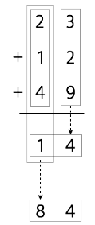
Logic programming has been around for a while. A language that was quite popular during one of the last heydays of AI was Prolog. It is a language that uses only three constructs:
_{• Facts}
_{• Rules}
_{• Questions}
In order to understand logic programming, it's necessary to understand the concepts
of computation and deduction. To compute something, we start with an expression
and a set of rules. This set of rules is basically the program. Expressions and rules are used to generate the output.
Example: Let’s compute the sum of 23, 12, 49
The procedure to complete the operation would be as follows:
1. Add 3 + 2 + 9 = 14
2. We need to keep a single digit, which is the 4, and then we carry the 1
3. Add 2 + 1 + 4 (plus the 1 we carried) = 8
4. Combine 8 and 4. The final result is: 84

Slide 6
Understanding the building blocks of logic programming
Predicate Calculus
Predicate calculus also called logic of quantifiers is mathematical representation of formal logic that used for logic programming
FOPL, First-order programming logic refers to logic in which the predicate of a sentence or statement can only refer to a single subject
FOPL
Higher-order
PL
Symbolic
Logic
Logic
Formalism
Proposition

Slide 7
Understanding the building blocks of logic programming (1)
Predicate Calculus
Symbolic logic used for the three basic need of formal logic
to express propositions
to express the relationships between propositions
to describe how new propositions can be inferred from other propositions that are assumed to be true
Formal logic was developed to provide a method for describing proposition.
Proposition is a logical statement also known as fact
Consist of object and relationships of object to each other
FOPL
Higher-order
PL
Symbolic
Logic
Logic
Formalism
Proposition

Slide 8
Proposition
Object:
Constant represents an object, or
Variable represent different objects at different times
Simple proposition called as atomic propositions, consist of compound terms – one element of mathematic relation which written in a form that has the appearance of mathematical function notation.
Example (constants):
single parameter (1-tuple): man(jake)
double parameter (2-tuples): like(bob,steak)
List of parameter
functor shows the names the relation

Slide 9
Proposition
Two modes for proposition:
proposition defined to be true (fact), and
the truth of the proposition is something that is to be determined (queries)
Compound propositions have two or more atomic proposition, which are connected by logical operator (is the same way logic expression in imperative languages)

Slide 10
Logic operators
Name | Symbol | Example | Meaning
negation | ¬ | ¬ a | not a
conjunction | ∩ | a ∩ b | a and b
disjunction | ∪ | a ∪ b | a or b
equivalence | ≡ | a ≡ b | a is equivalent to b
implication | ⊃ | a ⊃ b | a implies b
 | ⊂ | a ⊂ b | b implies a

Slide 11
Truth tables
A | B | ~A | ~B | A ∪ B | A ∩ B | A ⊃ B
T | T | F | F | T | T | T
F | T | T | F | T | F | T
T | F | F | T | T | F | F
F | F | T | T | F | T | T

Slide 12
Compound propositions
Example:
a ∩ b ⊃ c
a ∩ ¬b ⊃ d
Precedence:
¬
∩ ∪ ≡
⊃ ⊂
higher
lower

Slide 13
Variables in proposition
Variable known as quantifiers
Predicate calculus includes two quanifiers, X – variable, and P – proposition
Name | Example | Meaning
universal | ∀X,P | For all X, P is true
existential | ∃X,P | There exists a value of X such that P is true

Slide 14
Example: variable in proposition
Example
∀X.(woman(X) ⊃ human(X))
∃X.(mother(mary,X) ∩ male(X))
Notes:
untuk berapapun nilai X, jika X adalah perempuan, maka X adalah manusia (NL: perempuan adalah manusia)
terdapat nilai X sehingga mary adalah ibu dari X dan X adalah laki-laki (NL: mary mempunyai seorang putra)

Slide 15
Variables in Proposition
Example
∀X.(woman(X) ⊃ human(X))
⇒ for any value of X, if X is a woman, then X is a human (NL: woman is a human)
∃X.(mother(mary,X) ∩ male(X))
⇒ there exist a value of X such that mary is the mother of X and X is a male (NL: mary has a son)

Slide 16
Clausal Form
Simple form of proposition, it is a standard form for proposition without loss of generality
Why we need to transform PC into CF?
too many different ways of stating propositions that have the same meaning
Example:
∀X.(woman(X) ⊃ human(X))
∀X.(man(X) ⊃ human(X))
Notes:
Bentuk proposisi sederhana, merupakan bentuk standar proposisi tanpa kehilangan keumumannya

Slide 17
Clausal Form
General syntax for CF
B₁ ∪ B₂ ∪ … ∪ B_{n} ⊂ A₁ ∩ A₂ ∩ … ∩ A_{m}
⇒ if all the As are true, then at least one B is true
Example:
human(X) ⊂ woman(X) ∩ man(X)
likes(bob, trout) ⊂ likes(bob, fish) ∩ fish(trout)

Slide 18
Clausal Form
Example:
likes(bob, trout) ⊂ likes(bob, fish) ∩ fish(trout)
Characteristics of CF:
Existential quantifiers are not required
Universal quantifiers are implicit in the use of variables in the atomic propositions
No operator other than conjunction and disjunction are required
consequent
antecedent

Slide 19
Clausal Form
Example:
likes(bob, trout) ⊂ likes(bob, fish) ∩ fish(trout)
⇒ if bob likes fish and trout is a fish, then bob likes trout

Slide 20
Clausal Form
Example:
father(louis, al) ∪ father(louis, violet) ⊂ father(al,bob) ∩ mother(violet, bob) ∩ grandfather(louis, bob)
⇒ if al is bob’s father and violet is bob’s mother and louis is bob’s grandfather, louis is either al’s father or violet’s father

Slide 21
Proving Theorems
Method to inferred the collection of proposition
use a collections of proposition to determine whether any interesting or useful fact can be inferred from them
Introduced by Alan Robinson (1965)

Slide 22
Proving Theorems
Alan Robinson introduced resolution in automatic theorem proving
resolution is an inference rule that allows inferred proposition to be computed from given propositions
resolution was devised to be applied to propositions in clausal form

Slide 23
Proving Theorems
Idea of resolution:
P1 ⊂ P2 and Q1 ⊂ Q2
which given
P1 is identical to Q2
∴ Q1 ⊂ P2
Notes:
Jika P2 maka P1,
Q2 maka Q1
P1=Q2
P2 maka Q1

Slide 24
Proving Theorems
Example:
older(joanne, jake) ⊂ mother(joanne, jake)
wiser(joanne, jake) ⊂ older(joanne, jake)
∴ wiser(joanne, jake) ⊂ mother(joanne, jake)

Slide 25
Solving problems using logic programming
Logic programming looks for solutions by using facts and rules. A goal must be specified for each program. When a logic program and a goal don't contain any variables, the solver comes up with a tree that constitutes the search space for solving the problem and getting to the goal.
Let's consider the following:
Kathy orders dessert => Kathy is happy
This can be read as an implication that says, If Kathy is happy, then Kathy orders dessert.
It can also be construed as Kathy orders dessert whenever she is happy

Slide 26
Solving problems using logic programming (1)
let's consider the following rules and facts:
canfly(X) :- bird(X), not abnormal(X).
abnormal(X) :- wounded(X).
bird(john).
bird(mary).
wounded(john).
Here is how to interpret the rules and facts:
• John is wounded
• Mary is a bird
• John is a bird
• Wounded birds are abnormal
• Birds that are not abnormal can fly
From this, we can conclude that Mary can fly, and John cannot fly.

Slide 27
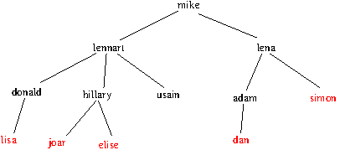
Family tree
male(lennart).
male(mike).
male(donald).
male(usain).
male(joar).
male(adam).
male(dan).
male(simon).
female(hillary).
female(elise).
female(lisa).
female(lena).
parent(mike, lennart).
parent(mike, lena).
parent(lennart, donald).
parent(lennart, hillary).
parent(lennart, usain).
parent(lena, adam).
parent(lena, simon).
parent(adam, dan).
parent(donald, lisa).
parent(hillary, joar).
parent(hillary, elise).
child(lisa).
child(joar).
child(elise).
child(dan).
child(simon).

Slide 28
Family tree
%% predicate rules
father(X,Y) :- male(X),parent(X,Y).
mother(X,Y) :- female(X),parent(X,Y).
son(X,Y) :- male(X),parent(Y,X).
daughter(X,Y) :- female(X),parent(Y,X).
family_children(X, X):-child(X).
family_children(X, Child):-parent(X,Y), family_children(Y, Child).

Slide 29
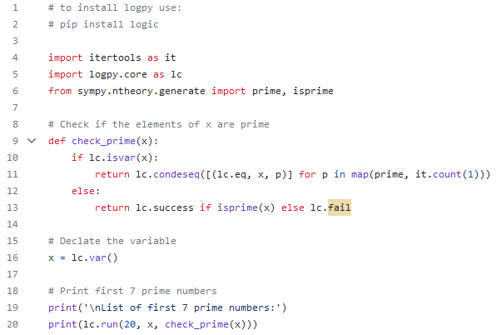

Validating primes
OUTPUT

Slide 30
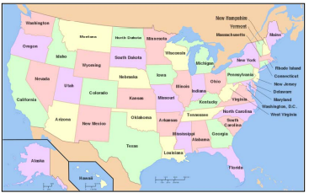
Analyzing geography
Let's use logic programming to build a solver to analyze geography. In this problem, we will specify information about the location of various states in the US and then query the program to answer various questions based on those facts and rules. The following is a map of the US:

Slide 31
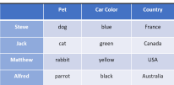
Building a puzzle solver
Another interesting application of logic programming is solving puzzles. We can specify the conditions of a puzzle and the program will come up with a solution. In this section, we will specify various bits and pieces of information about four people and ask for the missing piece of information. In the logic program, we specify the puzzle as follows:
Steve has a blue car.
The person who owns a cat lives in Canada. Matthew lives in the USA.
The person with a black car lives in Australia.
Jack has a cat.
Alfred lives in Australia.
The person who has a dog lives in France.
Who has a rabbit?
The goal is the find the person who has a rabbit. Here are the full details about the four people.

Slide 32


Thank you

